Slide 1
DevOps for AI
LearnAI - Team

Slide 2
What is DevOps?

Slide 3

DevOps
DevOps brings together people, processes, and technology automating software delivery to provide continuous value to users.
Continuous Integration (CI)
Focuses on blending the work of individual developers together into a repository.
Each time you commit code, it’s automatically built and tested, and bugs are detected faster.
Continuous Deployment (CD)
Automate the entire process from code commit to production if your CI/CD tests are successful.
Continuous Learning & Monitoring
Using CI/CD practices, paired with monitoring tools, safely deliver features to your customers as soon as they’re ready.

Slide 4
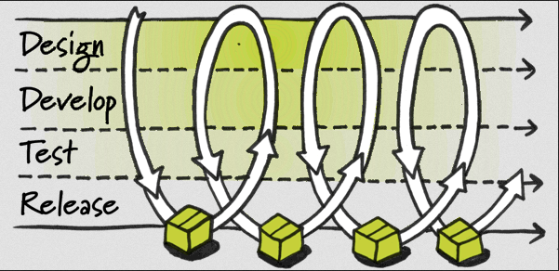
Continuous Delivery
Build software that is always ready to be deployed into production

Slide 5
Continuous Delivery Cont.
Is this a new idea?
1st principle of the Agile Manifesto:
“Our highest priority is to satisfy the customer through early and continuous delivery of valuable software”
Goal: Release to production more often
Monthly
Weekly
Daily

Slide 6
Continuous Delivery Cont.
Pros: Receive many benefits from the Agile process as well as others
Build the right product
Constant feedback from customers
Write thorough acceptance tests
Earlier benefits
Get product out before competitors
Find bugs earlier

Slide 7
Continuous Delivery Cont.
Ability to react quickly to change
Adopt to new requirements quickly
Save money and time with automation
As deploying to production becomes easier, more time can be spent developing valuable features

Slide 8
Continuous Integration
Vital step when practicing CD
To practice CI, every developer on a project must integrate their work daily with every other developer
Everyone on the team needs to practice this for it to work
Continuous integration is not a tool, but a technique

Slide 9
Continuous Integration
Things a CI server can do:
After you check-in code it can:
Run build/test scripts
Notify developers of a failed build or failed tests
Can show all past check-ins and if they failed or passed all the tests
Can keep track of multiple projects
Plus much more!!

Slide 10
DevOps for AI Development
Can be used to manage pain points
Integration between data scientists and software engineers
Scripts stored on one person's machine and process are not repeatable by anyone else
Model versioning based on names, hard to know where model is deployed
Accuracy of model is determined during training and might change over time because of the data drift
Determine the value of the trained model, decide if it should be deployed

Slide 11
Model Lifecycle Management

Slide 12
Building your own AI models
Transforming data into intelligence
Prepare data
Build and train
Deploy

Slide 13


Data science workflow
Prepare
Experiment
Deploy
…
Prepare Data
Build model (your favorite IDE)
Train & Test Model
Register and Manage Model
Build Image
Deploy Service
Monitor Model
Notes:
Here is the data scientist’s inner loop of work

Slide 14
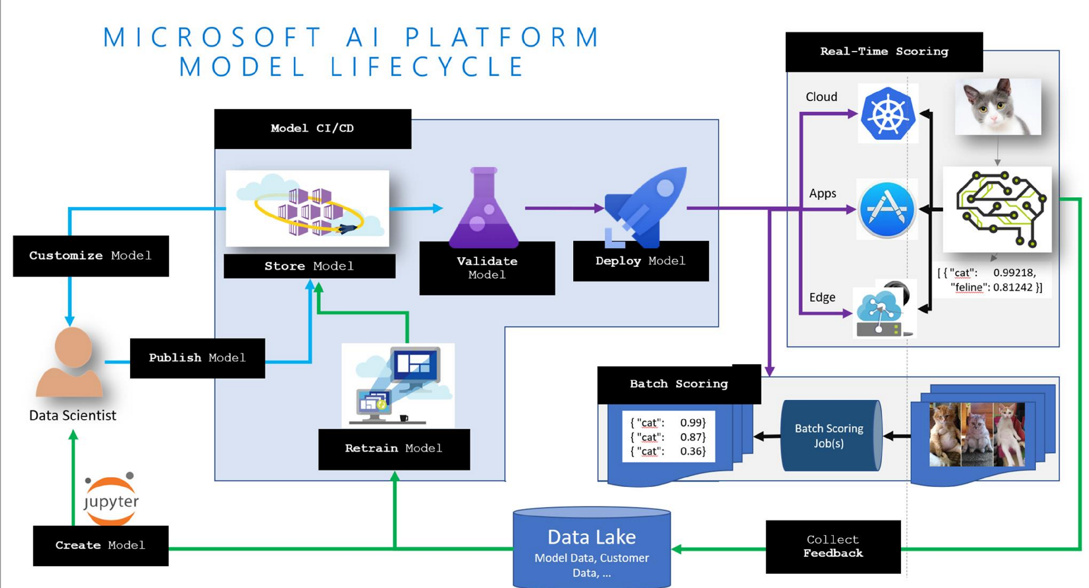
Model Lifecycle

Slide 15
What does DevOps for AI mean?

Slide 16
Produce Repeatable Experiments
80%
75%
90%
85%
Use well-defined pipelines to capture the E2E model training process
Capture run metrics, intermediate outputs, output logs and models
Use leaderboards, side by side run comparison and model selection
No matter where an experiment happens, track it in the cloud so you can explain how a model was created.

Slide 17
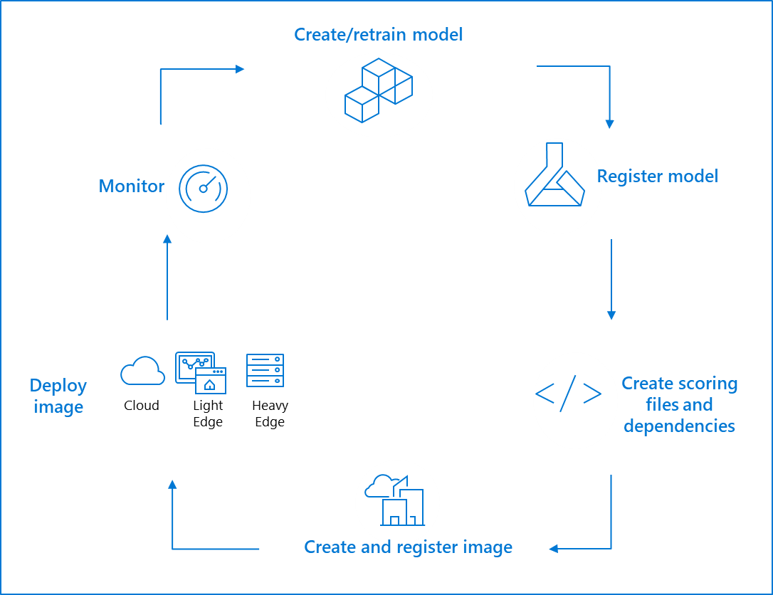
Manage Model Lifecycle
Track model versions & metadata with a centralized model registry
Leverage containers to capture runtime dependencies for inference
Leverage an orchestrator like Kubernetes to provide scalable inference for your real time services (scale / load balancing)
Capture model telemetry – health, performance, inputs / outputs
Encapsulate each step in the lifecycle to enable CI/CD and DevOps
Automatically optimize models to take advantage of hardware acceleration

Slide 18
Key Goals of DevOps for AI
Repeatability of model creation & behavior
Evaluation of model predictions
Managing different model versions and files
Operationalization of the model
Monitoring of training and scoring pipelines

Slide 19
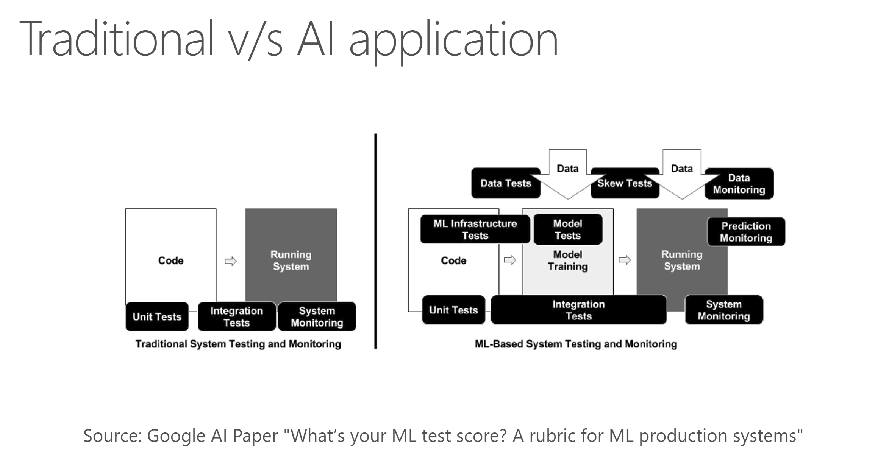

Slide 20
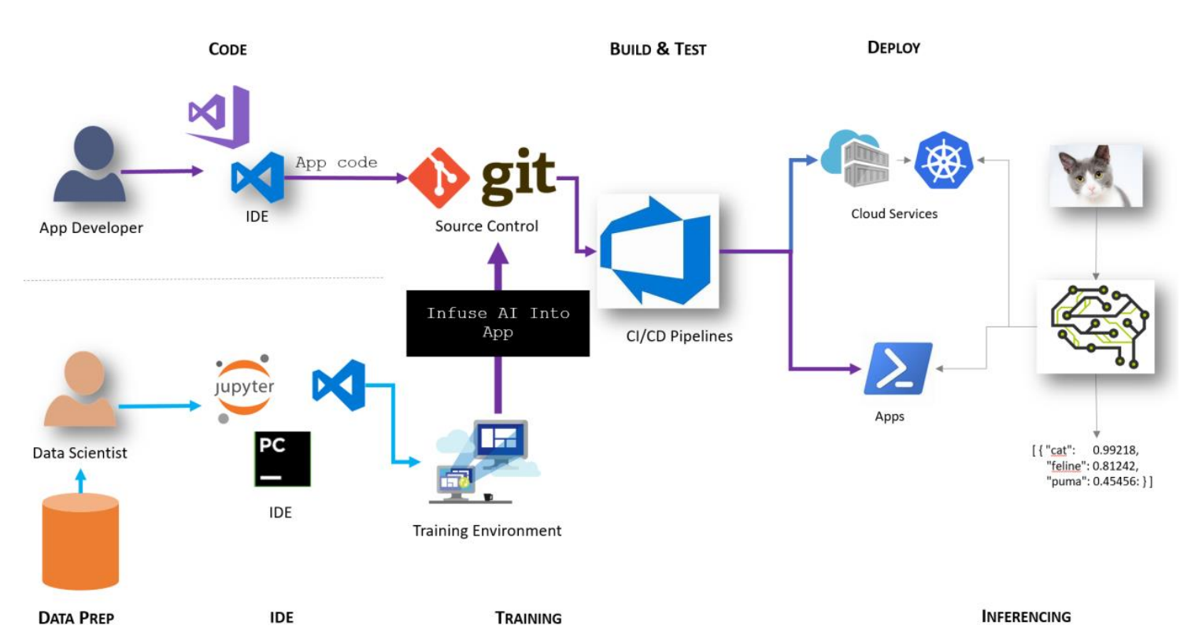
Step 1 – Infuse AI into App

Slide 21
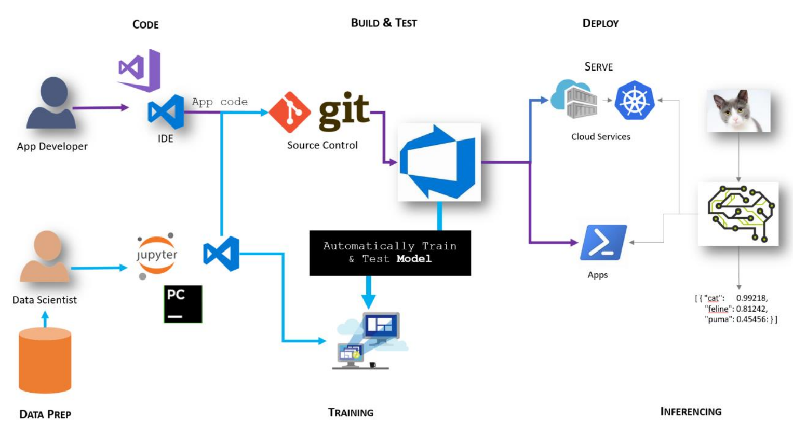
Step 2 – Automate Model Training

Slide 22
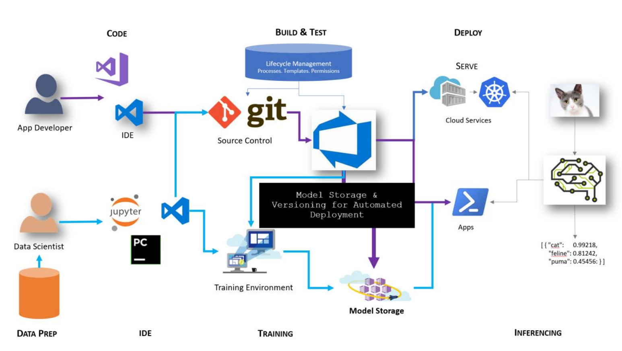
Step 3 – Store, Version and Validate Models

Slide 23
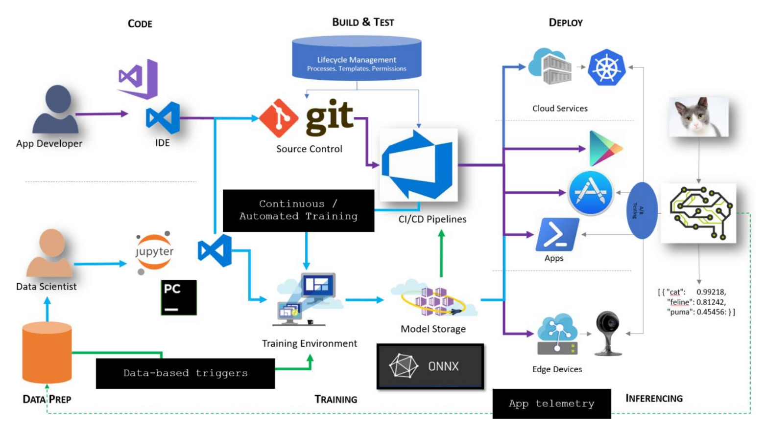
Step 4 – Automate Model Release
Notes:
Data prep needs to be versioned as part of training as well
Wrangling / training / inferencing
Ingress controller for routing
Traffic from k8s / aml is looking at istio
Confuse.com in UK

Slide 24

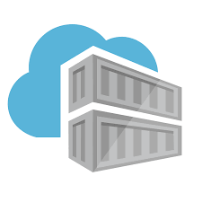



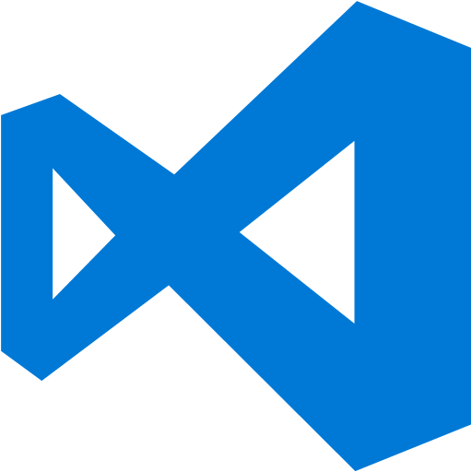




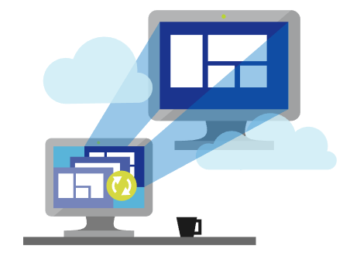
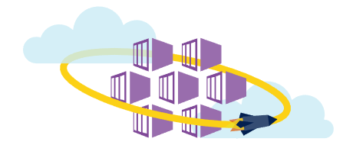
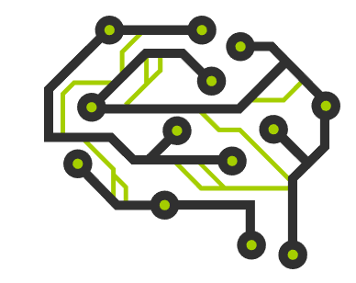
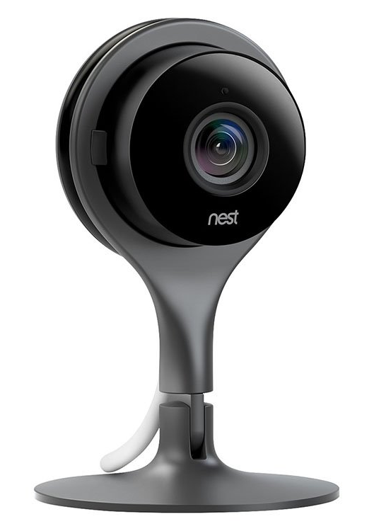

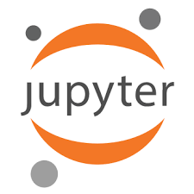

APP DEVELOPERS AND DATA SCIENTISTS TOGETHER
Update Application
CNTK/TF/SCIKIT
KERAS/ …
Deploy Application
Cloud Services
App Developer
IDE
DevOps Pipeline
Validate & Flight Model + App
Consume Model
Deploy Model
Apps
Customize Model
Model Store
Predict
Edge Devices
Publish Model
[ { "cat": 0.99218,
"feline": 0.81242 }]
Data Scientist
Retrain Model
Model Telemetry
Collect Feedback
IDE
Notes:
Make this slide animation.
Developer work on the IDE of their choice on the application code.
They commit the code to source control of their choice (VSTS has good support for various source controls)
Separately, Data scientist work on developing their model.
Once happy they publish the model to a model repository (we can extend this with Vienna)
A build is kicked off in VSTS based on the commit in GitHub.
VSTS Build pipeline pulls the latest model from Blob container (can be extended with Vienna Model Management Service) and creates a container.
VSTS pushes the image to private image repository in Azure Container Registry
On a set schedule (nightly), release pipeline is kicked off.
Latest image from ACR is pulled and deployed across Kubernetes cluster on ACS.
Users request for the app goes through DNS server.
DNS server passes the request to load balancer and sends the response back to user.

Slide 25
Azure Pipelines

Slide 26
Data Warehouse
MODEL CI/CD
Code change, trigger CI
New inference code, trigger release
Data Cooking Pipeline
DevOps Pipeline
TRAIN MODEL
Training code
Inference code
Git Repo
New training job is started whenever source code is pushed.
ML Pipeline handles dataPrep, training, evaluation – certifies the model is of high quality
Register Model
Data Lake
Unit Test Code
Model Store
Run Azure ML Pipeline
New data, trigger CI
Azure Data Factory Pipeline
Azure Databricks
Azure ML Compute (docker run)
Data Preparation Services (Labeling, Feedback, Drift)
New model registered, trigger release
Data movement / copy
Data cooking
Model training
Inference code has changed, trigger release pipeline
DEPLOY MODEL
DevOps Pipeline
Azure DevOps
Deploy to Azure Kubernetes Service (PROD)
Get Human Approval
Validate Model
Deploy to Azure Kubernetes Service (INT)
Package Model
Azure Machine Learning
Azure Data Factory
Inference Data
Notes:
[10:50 AM] Tim ScarfeJordan Edwards thanks for this! Assumptions: 1) the model store is keyed in some way on the build ID and/or the git commit id? 2) the ML pipeline is calling out to data bricks using the jobs API with python source checked into git i.e. not calling a mutable notebook
​
[11:23 AM] Jordan EdwardsTim Scarfe -
yes the model is pinned with the git commit as well as the pipeline / build ID (so you have an audit trail to exactly how it was produced)
yes the job should submit sources that are in git not in a magic notebook on the file system
<https://teams.microsoft.com/l/message/19:bfb1b4d771ff441393e2c89c9e80d14c@thread.skype/1547059832334?tenantId=72f988bf-86f1-41af-91ab-2d7cd011db47&amp;groupId=66aa6f64-da6b-491b-b2e3-8e43ae872a7c&amp;parentMessageId=1547054108278&amp;teamName=DevOps for A.I. V-Team&amp;channelName=General&amp;createdTime=1547059832334>
Ideally release in my opinion will be automated to a staging environment once a new model hits the model store, Then integration testing and then a manual release gate for deployment to production, so I would not have the arrow from the repo with inference code changes directly triggering a release ... changes to inference code should trigger the build pipeline too. Perhaps there is room for triggering a different build pipeline based on filter conditions (Path Filters) that follows a seperate path other that registering a new model ?

Slide 27
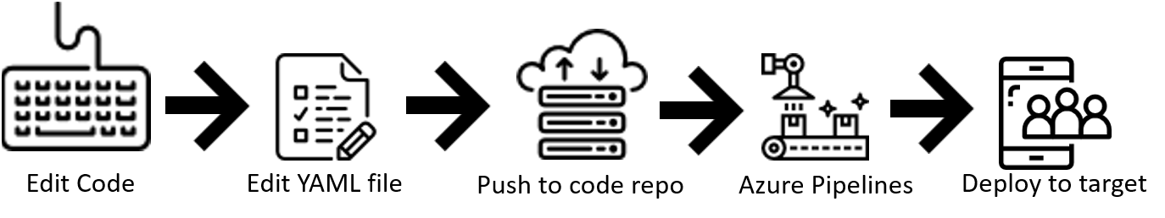
Use Azure Pipelines with YAML

Slide 28
Azure Pipelines
A cloud service that you can use to automatically build and test your code project and make it available to other users
Combines CI/CD to constantly and consistently test, and build your code in order to ship it to any target

Slide 29
Terminology
Build
A build represents one execution of a pipeline. It collects the logs associated with running the steps and the results of running tests
Build vs Release
A “build” is given by dev team to the test team. A “release” is formal release of the product to its customers
Trigger
A trigger is something that's set up to tell the pipeline when to run
Library
A collection of shared build and release assets for a project. Assets defined in a library can be used in multiple build and release pipelines of the project

Slide 30
Terminology
Agent
When your build or deployment runs, the system begins one or more jobs. An agent is installable software that runs one build or deployment job at a time
Microsoft-hosted agents:
With Microsoft-hosted agents, maintenance and upgrades are taken care of for you. Each time you run a pipeline, you get a fresh virtual machine
Self-hosted agents:
An agent that you set up and manage on your own to run build and deployment jobs is a self-hosted agent. More control to install dependent software needed for your builds and deployments

Slide 31
Terminology
Repositories
At the beginning of a pipeline, the agent downloads files from your repository into a local sources directory
Supported Repos
Azure Repos Git
Azure Repos TFVC
Bitbucket Cloud
External Git (generic)
GitHub
GitHub Enterprise
Subversion

